Slide 1
Welcome to Calculus II

Slide 2
Basic Course Information
Grading Scale
Homework (WebWork & Paper)
Attendance
Lecture and Discussion

Slide 3
The Nature of Calculus II
Review of Calculus I – Chapter 5 Highlights
Chapter 6 – Applications of Integrals
Chapter 7 – Evaluating Integrals by Hand
Chapter 8 – Sequences and Series
Chapter 9 - Vectors

Slide 4
Top Reasons Students Struggle
Inadequate Background
Personal Emergency
Lack of Discipline
Must spend at least 8 hrs/week studying and doing homework
Must learn derivative/integral rules
Must attend class and pay attention
Must ask questions when confused

Slide 5
The First Big Idea

Slide 6
Let’s Talk
What’s math really all about?

Slide 7
What’s Algebra All About?
Graphing Functions
Solving Equations
“Pushing Symbols Around”
Quantities That Don’t Change

Slide 8
Example
A train leaves Dallas traveling east at 60 mph.
After 3 hours, how far has it traveled?
Distance = Rate* Time
= 60 mph * 3h= 180 miles
y = m x

Slide 9
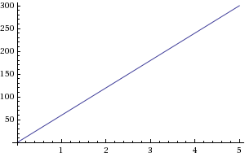
y = 60 x

Slide 10
What Algebra Can’t Do
This is the kind of fake example that gets mathematics laughed at on sit-coms.
Trains never travel 3 hours without changing speed, stopping, etc.

Slide 11
Experiment
Consider a particle that moves at 5 ft/sec for 3 seconds. How far does it go?
Distance = Rate * Time
Distance = 5 ft/sec * 3 sec = 15 ft

Slide 12
Now suppose the particle moves 5 ft/sec for 1 second, then
3 ft/sec for 2 seconds.
How far does it go?
Distance = Rate * Time
Distance = 5(1) + 3(2) = 11 ft

Slide 13
Next suppose the particle moves 5 ft/sec for 1 second, then
8 ft/sec for 1 second, then
3 ft/sec for 1 second.
How far does it go?
Distance = Rate * Time
Distance = 8(1) + 5(1) + 3(1) = 16 ft

Slide 14
Extend Our Experiment
Suppose a particle is moving with velocity t² + 1
from t=0 to t=3 seconds. How far does it go?
Distance = Rate * Time
Doesn’t really help, does it?

Slide 15
Break It Into Pieces
Let’s divide the interval from 0 to 3 into small pieces like the last examples.
0 to 1
1 to 2
2 to 3.
Δ t = 1 second

Slide 16
Pretend Speed Is Constant
When t = 0 sec, the speed is 1 ft/sec.
When t = 1 sec, the speed is 2 ft/sec.
When t = 2 sec, the speed is 5 ft/sec.
Let’s pretend the speed doesn’t change on each piece.

Slide 17
Use The Old Formula On Each Piece
Between 0 and 1 sec,
Distance = (1 ft/sec) * (1 sec) = 1 ft
Between 1 and 2 sec,
Distance = (2 ft/sec) * (1 sec) = 2 ft
Between 2 and 3 sec,
Distance = (5 ft/sec) * (1 sec) = 5 ft

Slide 18
Add Up The Pieces
Total Distance = Ʃ f(t) ∆t
= (1 + 2 + 5) ft
= 8 ft

Slide 19
Big Idea
Integration
Something was changing, so we couldn’t use the old algebra formulas.
Break the problem into pieces.
Pretend everything is constant on each piece.
Add up the pieces. (This is called a Riemann Sum)
If we use more and more pieces, the limit is the right answer! (This limit is a definite integral.)

Slide 20
Area
Finding area is exactly the same problem.
Area of a Rectangle = Height * Width

Slide 21
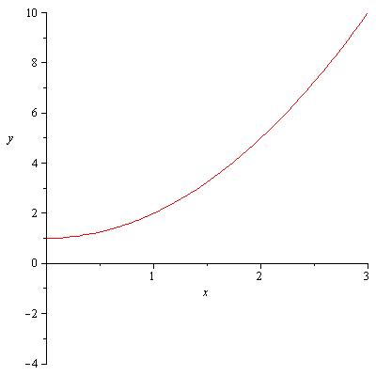
Area Under a Curve
What if the height is changing?
Area = Height * Width
Isn’t much help!

Slide 22
What Did We Just Do?
Something was changing, so we couldn’t use the old algebra formulas.
Break the problem into pieces.
Pretend everything is constant on each piece.
Add up the pieces. (Riemann Sum)
If we use more and more pieces, the limit is the right answer (definite integral)!

Slide 23
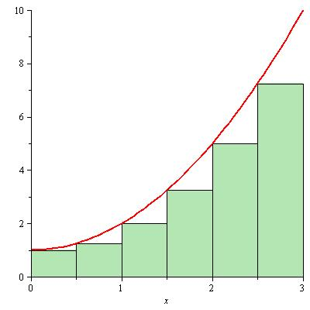
Use Left Endpoints
1 * 0.5
1.25 * 0.5
2 * 0.5
2.25 * 0.5
5 * 0.5
7.25 * 0.5
9.375
+

Slide 24
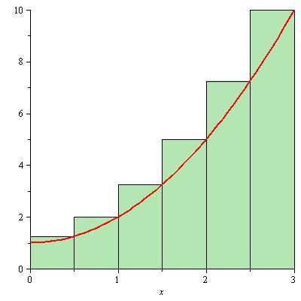
Use Right Endpoints
1.25 * 0.5
2 * 0.5
2.25 * 0.5
5 * 0.5
7.25 * 0.5
10 * 0.5
13.875
+

Slide 25
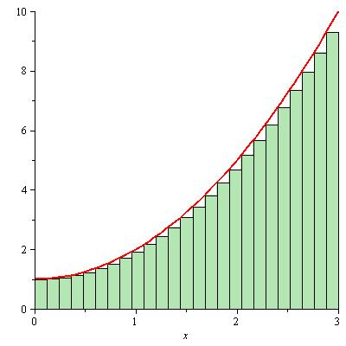
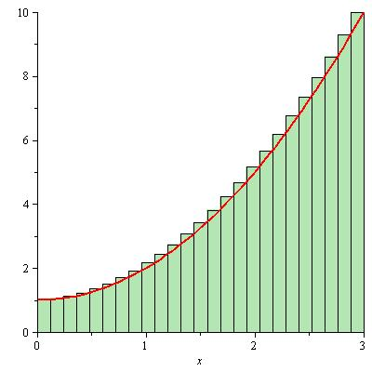
Use More Pieces
As we use more pieces, the sum gets closer and closer to 12.

